Slide 1
Case Study: How Does a Bike-Share Navigate Speedy Success?
Matteo Natalini
20/12/2022

Slide 2
Overview
The objective of this data exploration is to understand how casual riders and annual members use Cyclistic bikes differently.
From these insights, the marketing team will design a new marketing strategy to convert casual riders into annual members.

Slide 3
The data
Data was obtained directly from company records available at https://divvy-tripdata.s3.amazonaws.com/index.html
Data are from October 2021 to September 2022

Slide 4
Data Cleaning
Data have been cleaned and organized using Excel then SQL. (Details in ChangeLog attached).
The data has been processed to remove trips that were below 60 seconds in length, and trips longer than 24 hours where the bike was not returned to a station.

Slide 5
Understanding the problem
Question 1
Question 2
Question 3
How do annual members and casual riders use Cyclistic bikes differently?
Why would casual riders buy Cyclistic annual memberships?
How can Cyclistic use digital media to influence casual riders to become members?

Slide 6
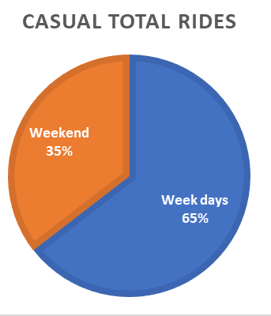
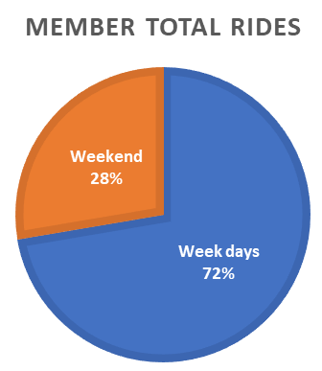
How do annual members and casual riders use
Cyclistic bikes differently?
Members use significantly more the bikes during week days .
We can deduct that member use the bike to commute to work.

Slide 7
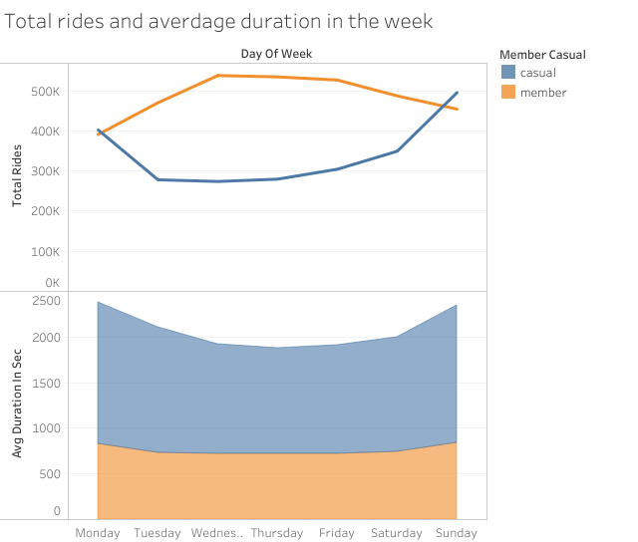
Trend analysis during the week
Finding
Members have a bigger number of trips in total, focused in the middle of the week.
Trips for casuals grow exponentially during the week end.
Casual have longer trips length than members
Data from April 2019 to March 2020

Slide 8
Why would casual riders buy Cyclistic annual memberships?
Casual could move to annual membership if there is an opportunity to save money during weekends or have a better rate on long rides

Slide 9
Proposed ideas to turn casuals in members
Idea 1
Offer discounted plan for longer rides
Idea 2
Advertise discount on week end trips

